Slide 1
Spinnaker Architecture
By OpxMx

Slide 2
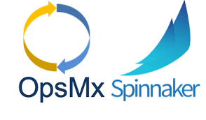
Architecture
Spinnaker Consists of number of Individual Components and they are Microservice architecture.
The Major Components are :-
Deck - (UI to Access Spinnaker)
Gate - (Manages All API Calls)
Orca - (Orchestration Engine, Responsible for Pipeline and other operations.)
Cloud-Driver - (Responsible to Make calls to Different Providers Eg:- AWS,Azure,Google … )
Front50 - (Hold Metadata of Application, Pipeline, Project, Notifications)
Rosco - (Responsible for producing immutable VM Images)
Igor - (Responsible to trigger pipeline)
Echo - (Responsible for Event Triggers, send notification to Slack,E-mail and so on..)
Fiat - (Responsible for Authorization in Spinnaker)
Kayenta - (Responsible for Canary Analysis)
Halyard - (Responsible for Managing all Spinnaker services and configuration using CLI, using this we can update, rollback and so on..,)

Slide 3
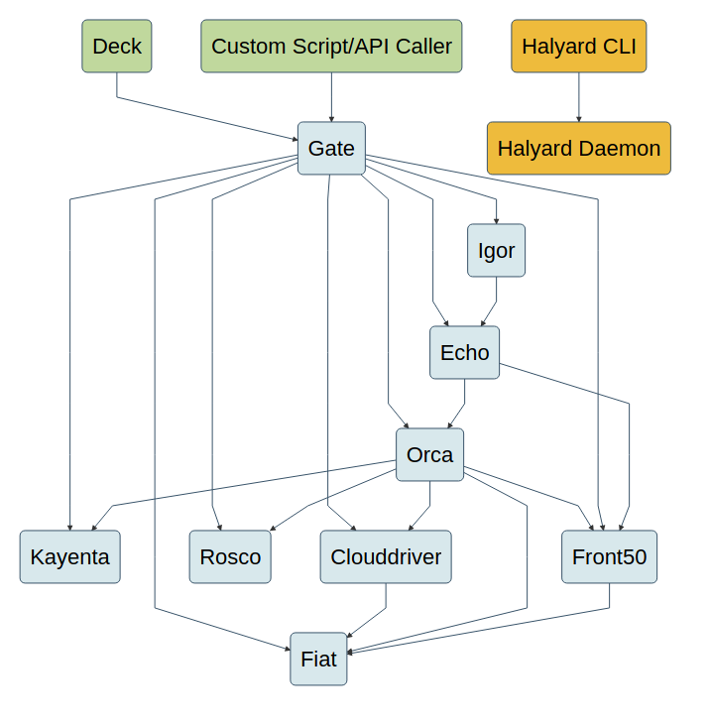
Architecture

Slide 4
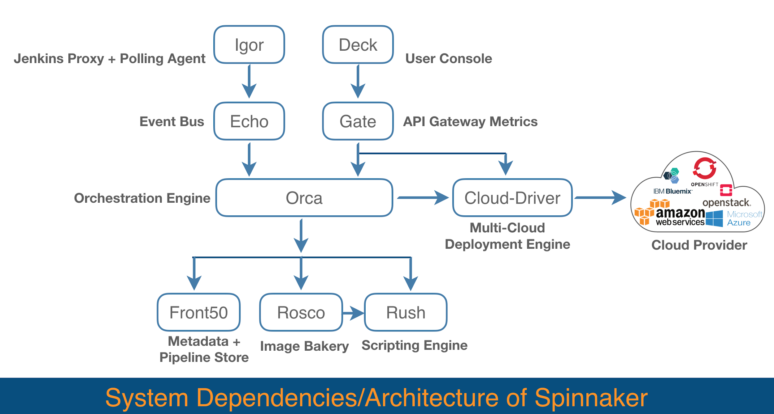
Architecture

Slide 5
Ports Used
Service | Port
Clouddriver | 7002
Deck | 9000
Echo | 8089
Fiat | 7003
Front50 | 8080
Gate | 8084
Halyard | 8064
Igot | 8088
Kayenta | 8090
Orca | 8083

Slide 6
Thank You :)

